Slide 1

CM20315 - Machine Learning
Prof. Simon Prince
7a. Gradients

Slide 2
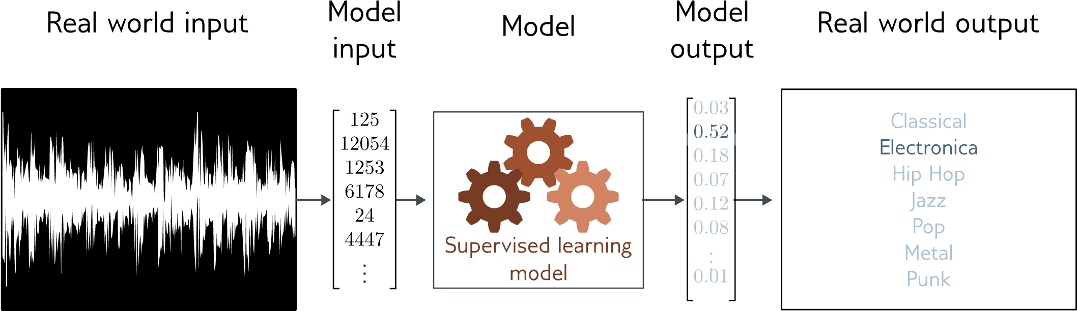
Music genre classification
Multiclass classification problem (discrete classes, >2 possible values)
Convolutional network

Slide 3
Loss function
Training dataset of I pairs of input/output examples:
Loss function or cost function measures how bad model is:
or for short:
Returns a scalar that is smaller when model maps inputs to outputs better

Slide 4
Example

Slide 5
Problem 1: Computing gradients
Loss: sum of individual terms:
SGD Algorithm:
Parameters:
Need to compute gradients

Slide 6
Why is this such a big deal?
A neural network is just an equation:
But it’s a huge equation, and we need to compute derivative
for every parameter
for every point in the batch
for every iteration of SGD

Slide 7
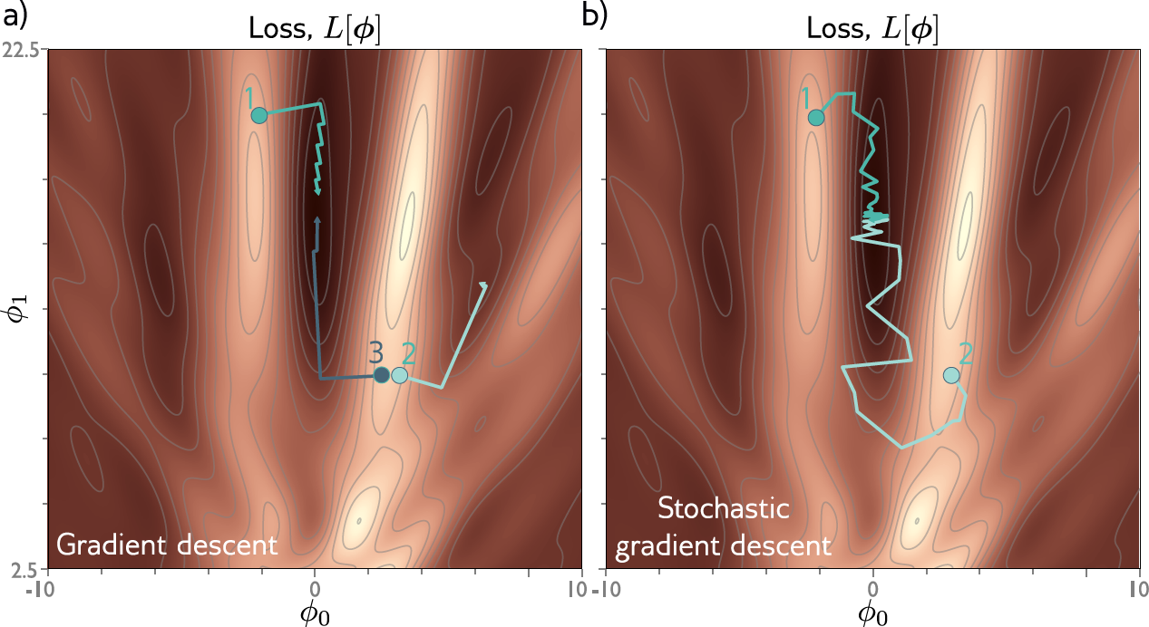
Problem 2: initialization
Where should we start the parameters before we commence SGD?

Slide 8
Gradients
Backpropagation intuition
Toy model
Background mathematics
Backpropagation forward pass
Backpropagation backward pass
Algorithmic differentiation
Code

Slide 9
Problem 1: Computing gradients
Loss: sum of individual terms:
SGD Algorithm:
Parameters:
Need to compute gradients

Slide 10
Algorithm to compute gradient efficiently
“Backpropagation algorithm”
Rumelhart, Hinton, and Williams (1986)

Slide 11
BackProp intuition #1: the forward pass
Orange weight multiplies activation (ReLU output) in previous layer
We want to know how change in orange weight affects loss
If we double activation in previous layer, weight will have twice the effect
Conclusion: we need to know the activations at each layer.

Slide 12
BackProp intuition #2: the backward pass
To calculate how a small change in a weight or bias feeding into hidden layer h₃ modifies the loss, we need to know:
how a change in layer h₃ changes the model output f
how a change in model output changes the loss l

Slide 13
BackProp intuition #2: the backward pass
To calculate how a small change in a weight or bias feeding into hidden layer h₂ modifies the loss, we need to know:
how a change in layer h₂ affects h₃
how h₃ changes the model output
how this output changes the loss

Slide 14
BackProp intuition #2: the backward pass
To calculate how a small change in a weight or bias feeding into hidden layer h₁ modifies the loss, we need to know:
how a change in layer h₁ affects layer h₂
how a change in layer h₂ affects layer h₃
how layer h₃ changes the model output
how the model output changes the loss

Slide 15
Gradients
Backpropagation intuition
Toy model
Background mathematics
Backpropagation forward pass
Backpropagation backward pass
Algorithmic differentiation
Code

Slide 16
Toy function
Consists of a series of functions that are composed with each other.
Unlike in neural networks just uses scalars (not vectors)
“Activation functions” sin, exp, cos

Slide 17
Toy function
Derivatives

Slide 18
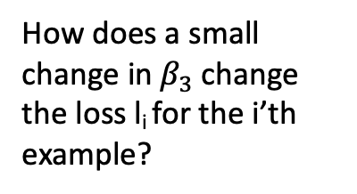
Gradients of toy function
We want to calculate:
How does a small
change in${ β}_{3}$change the loss l_{i} for the i’th example?

Slide 19
Gradients of composed functions
Calculating expressions by hand:
some expressions very complicated.
obvious redundancy (look at sin terms in bottom equation)

Slide 20
Forward pass
1. Write this as a series of
intermediate calculations
2. Compute these intermediate quantities

Slide 21
Forward pass
1. Write this as a series of
intermediate calculations
2. Compute these intermediate quantities

Slide 22

Forward pass
1. Write this as a series of
intermediate calculations
2. Compute these intermediate quantities

Slide 23
Backward pass
1. Compute the derivatives of the loss with respect to these intermediate quantities, but in reverse order.

Slide 24

Backward pass
1. Compute the derivatives of the loss with respect to these intermediate quantities, but in reverse order.

Slide 25
Backward pass
1. Compute the derivatives of the loss with respect to these intermediate quantities, but in reverse order.
The first of these derivatives is trivial

Slide 26
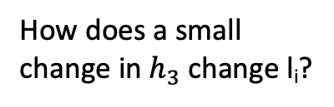
Backward pass
1. Compute the derivatives of the loss with respect to these intermediate quantities, but in reverse order.
The second of these derivatives is computed via the chain rule
How does a small
change in${ h}_{3}$change l_{i}?

Slide 27
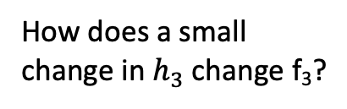
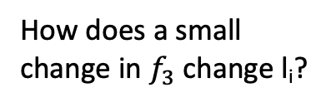
Backward pass
1. Compute the derivatives of the loss with respect to these intermediate quantities, but in reverse order.
The second derivative is computed via the chain rule
How does a small
change in${ f}_{3}$change l_{i}?
How does a small
change in${ h}_{3}$change l_{i}?
How does a small
change in${ h}_{3}$change f₃?

Slide 28
Backward pass
1. Compute the derivatives of the loss with respect to these intermediate quantities, but in reverse order.
The second of these derivatives is computed via the chain rule
Already computed!
How does a small
change in${ h}_{3}$change l_{i}?
ω₃

Slide 29
Backward pass
1. Compute the derivatives of the loss with respect to these intermediate quantities, but in reverse order.
The remaining derivatives also calculated by further use of chain rule

Slide 30
Backward pass
1. Compute the derivatives of the loss with respect to these intermediate quantities, but in reverse order.
The remaining derivatives also calculated by further use of chain rule
Already computed!
-sin[f₂]

Slide 31
Backward pass
1. Compute the derivatives of the loss with respect to these intermediate quantities, but in reverse order.
The remaining derivatives also calculated by further use of chain rule

Slide 32
Backward pass
1. Compute the derivatives of the loss with respect to these intermediate quantities, but in reverse order.
The remaining derivatives also calculated by further use of chain rule

Slide 33
Backward pass
1. Compute the derivatives of the loss with respect to these intermediate quantities, but in reverse order.
The remaining derivatives also calculated by further use of chain rule

Slide 34
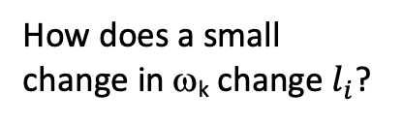
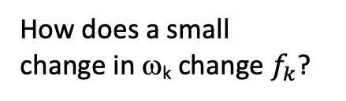
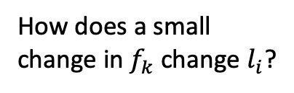
Backward pass
2. Find how the loss changes as a function of the parameters β and ω.
Another application of the chain rule
How does a small
change in${ f}_{k}$change $l_{i}$?
How does a small
change in$\text{w}\text{k}$ change $l_{i}$?
How does a small
change in$\text{w}\text{k}$ change${ f}_{k}$?

Slide 35
Backward pass
2. Find how the loss changes as a function of the parameters β and ω.
Another application of the chain rule
Already calculated in part 1.
How does a small
change in$\text{w}\text{k}$ change $l_{i}$?
h_{k}

Slide 36
Backward pass
2. Find how the loss changes as a function of the parameters β and ω.
Another application of the chain rule
Similarly for β parameters

Slide 37
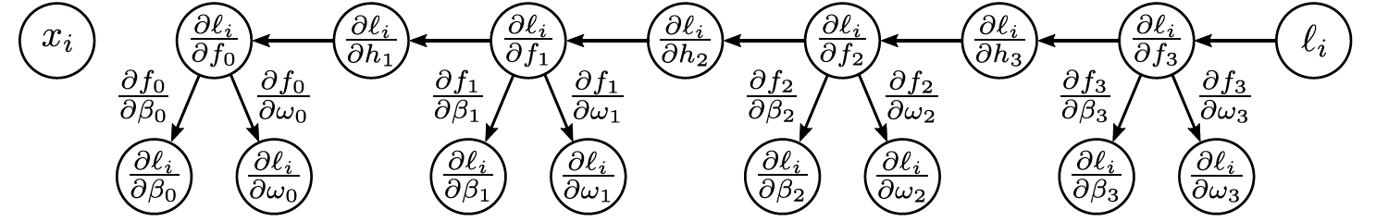
Backward pass
2. Find how the loss changes as a function of the parameters β and ω.

Slide 38
Gradients
Backpropagation intuition
Toy model
Background mathematics
Backpropagation forward pass
Backpropagation backward pass
Algorithmic differentiation
Code

Slide 39
Matrix calculus
Scalar function f[] of a vector a

Slide 40
Matrix calculus
Scalar function f[] of a matrix A

Slide 41
Matrix calculus
Vector function f[] of vector a

Slide 42
Comparing vector and matrix
Scalar derivatives:

Slide 43
Comparing vector and matrix
Scalar derivatives:
Matrix derivatives:

Slide 44
Comparing vector and matrix
Scalar derivatives:
Matrix derivatives:

Slide 45
Homework: (keeners only)
Consider function:
Can write as:
Now calculate:
Write final expression as a matrix
Notes:
\frac{\partial \bff}{\partial \bfa} = \begin{bmatrix}
\frac{\partial f_{1}}{\partial a_{1}} & \frac{\partial f_{2}}{\partial a_{1}} & \frac{\partial f_{3}}{\partial a_{1}}\\
\frac{\partial f_{1}}{\partial a_{2}} & \frac{\partial f_{2}}{\partial a_{2}} & \frac{\partial f_{3}}{\partial a_{2}}\\
\frac{\partial f_{1}}{\partial a_{3}} & \frac{\partial f_{2}}{\partial a_{3}} & \frac{\partial f_{3}}{\partial a_{3}}\\
\frac{\partial f_{1}}{\partial a_{4}} & \frac{\partial f_{2}}{\partial a_{4}} & \frac{\partial f_{4}}{\partial a_{4}}
\end{bmatrix}

Slide 46
Gradients
Backpropagation intuition
Toy model
Background mathematics
Backpropagation forward pass
Backpropagation backward pass
Algorithmic differentiation
Code

Slide 47
The forward pass
1. Write this as a series of
intermediate calculations

Slide 48
The forward pass
1. Write this as a series of
intermediate calculations
2. Compute these intermediate quantities

Slide 49
The backward pass
1. Write this as a series of
intermediate calculations
2. Compute these intermediate quantities
3. Take derivatives of output with respect to intermediate quantities

Slide 50
Gradients
Backpropagation intuition
Toy model
Background mathematics
Backpropagation forward pass
Backpropagation backward pass
Algorithmic differentiation
Code

Slide 51
The backward pass
1. Write this as a series of
intermediate calculations
2. Compute these intermediate quantities
3. Take derivatives of output with respect to intermediate quantities

Slide 52
Yikes!
But:
Quite similar to:

Slide 53
The backward pass
1. Write this as a series of
intermediate calculations
2. Compute these intermediate quantities
3. Take derivatives of output with respect to intermediate quantities

Slide 54
The backward pass
1. Write this as a series of
intermediate calculations
2. Compute these intermediate quantities
3. Take derivatives of output with respect to intermediate quantities

Slide 55
Derivative of ReLU

Slide 56
Derivative of ReLU
“Indicator function”

Slide 57
Derivative of RELU
where:
1. Consider:
2. We could equivalently write:
3. Taking the derivative
4. We can equivalently pointwise multiply by diagonal

Slide 58
The backward pass
1. Write this as a series of
intermediate calculations
2. Compute these intermediate quantities
3. Take derivatives of output with respect to intermediate quantities

Slide 59
The backward pass
1. Write this as a series of
intermediate calculations
2. Compute these intermediate quantities
3. Take derivatives of output with respect to intermediate quantities
4. Take derivatives w.r.t.
parameters

Slide 60
The backward pass
1. Write this as a series of
intermediate calculations
2. Compute these intermediate quantities
3. Take derivatives of output with respect to intermediate quantities
4. Take derivatives w.r.t.
parameters

Slide 61
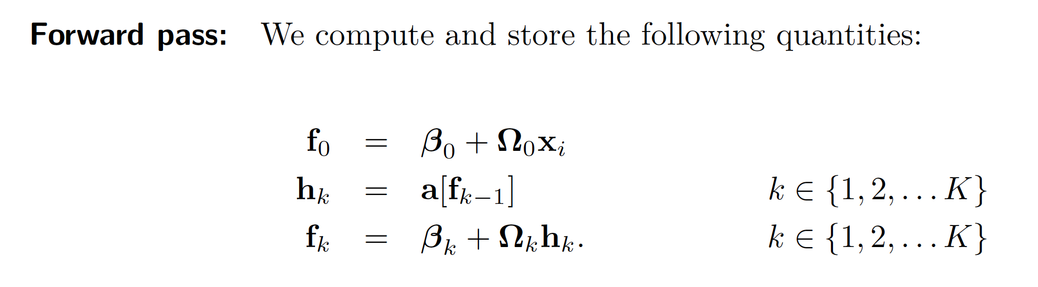
Backprop summary

Slide 62

Backprop summary

Slide 63
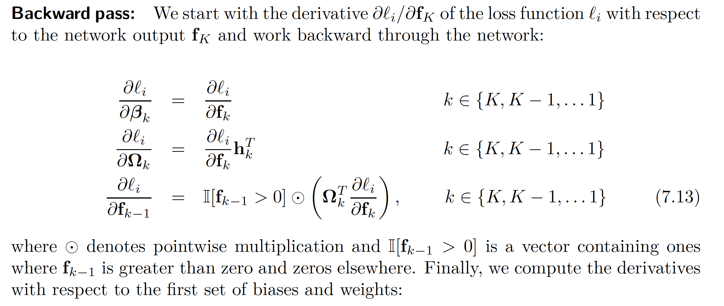
Backprop summary

Slide 64
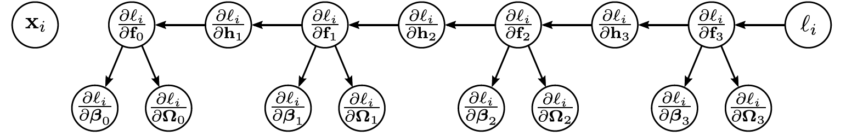
Backprop summary

Slide 65
Backprop summary

Slide 66
Backprop summary

Slide 67
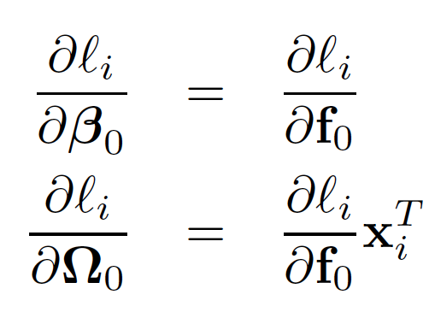
Backprop summary

Slide 68
Pros and cons
Extremely efficient
Only need matrix multiplication and thresholding for ReLU functions
Memory hungry – must store all the intermediate quantities
Sequential
can process multiple batches in parallel
but things get harder if the whole model doesn’t fit on one machine.

Slide 69
Gradients
Backpropagation intuition
Toy model
Background mathematics
Backpropagation forward pass
Backpropagation backward pass
Algorithmic differentiation
Code

Slide 70
Algorithmic differentiation
Modern deep learning frameworks compute derivatives automatically
You just have to specify the model and the loss
How? Algorithmic differentiation
Each component knows how to compute its own derivative
ReLU knows how to compute deriv of output w.r.t. input
Linear function knows how to compute deriv of output w.r.t. input
Linear function knows how to compute deriv of output w.r.t. parameter
You specify how the order of the components
It can compute the chain of derivatives
Works with branches as long as it’s still an acyclic graph

Slide 71
Gradients
Backpropagation intuition
Toy model
Background mathematics
Backpropagation forward pass
Backpropagation backward pass
Algorithmic differentiation
Code

Slide 72
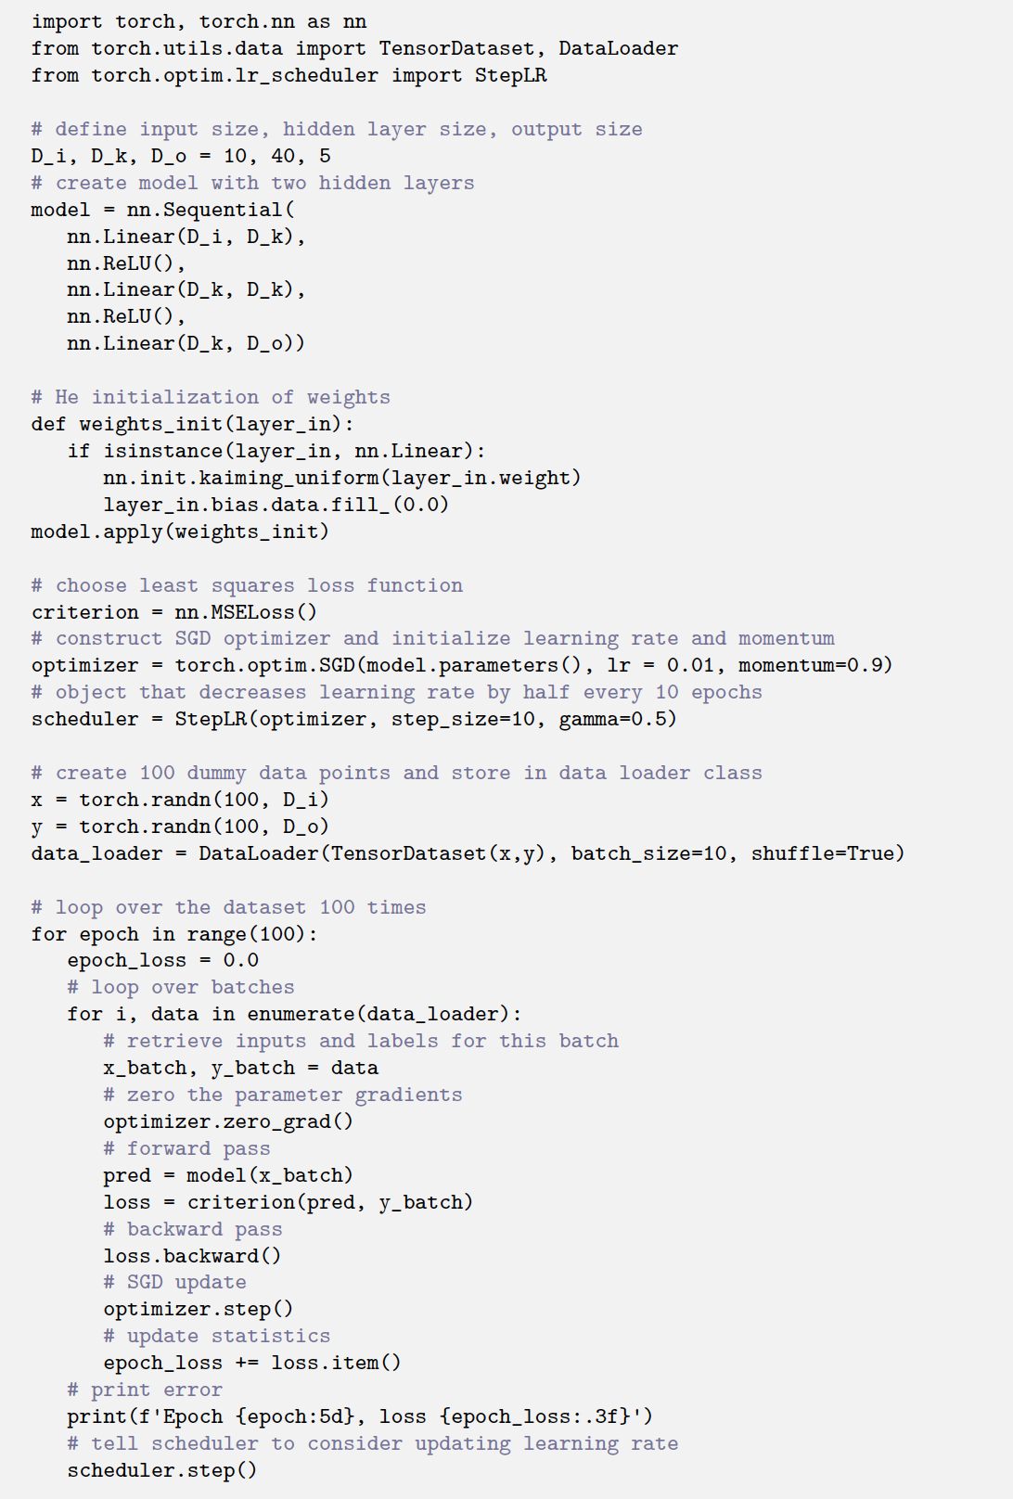
PyTorch code
Define a neural network
Initialize params with He initialization
Define loss function
Choose optimization algorithm
Choose initial learning rate
Choose learning rates schedule
Make some random data
Train for 100 batches

Slide 73
PyTorch code
Define a neural network
Initialize params with He initialization
Define loss function
Choose optimization algorithm
Choose initial learning rate
Choose learning rates schedule
Make some random data
Train for 100 batches

Slide 74
PyTorch code
Define a neural network
Initialize params with He initialization
Define loss function
Choose optimization algorithm
Choose initial learning rate
Choose learning rates schedule
Make some random data
Train for 100 batches

Slide 75

Feedback

